Slide 1
Microsoft Decides Computers aren’t enough
An analysis of what steps Microsoft should be taking in order to succeed in Hollywood
By SAAD RAEES

Slide 2

Microsoft’s issues
Microsoft is entering the market for the first time
Even though they have name in tech, we do not know how consumers would welcome them in a totally different industry
We are not aware of how lucrative the industry has gotten over time or if it hasn’t at all

Slide 3

What we will be looking at
We will be looking at some graphs that I have plotted from the data we have gathered. These are the csv files used
C:\Users\saadr\Documents\bom.movie_gross.csv
C:\Users\saadr\Downloads\IMDB-Movie-Data.csv

Slide 4

Revenue over time: As you can see in this graph, the revenue generation has gone up many folds over the decades. However, most movies do not make it to the top tier, they still make a decent revenue on movies

Slide 5
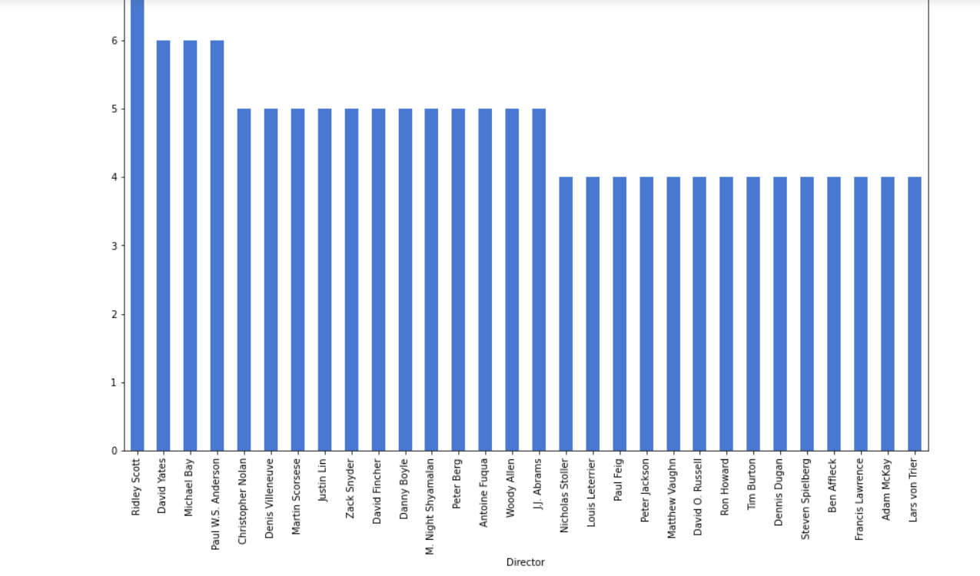
Directors with the most movies
Here is a graph of directors who have made the most amount of movies. We suggest hiring such directors because of the name recognition they have as compared to someone not as well known. Factors like these definitely help in marketing.
Ridley Scott, David Yates and Michael Bay are three of the most experienced directors out ther

Slide 6
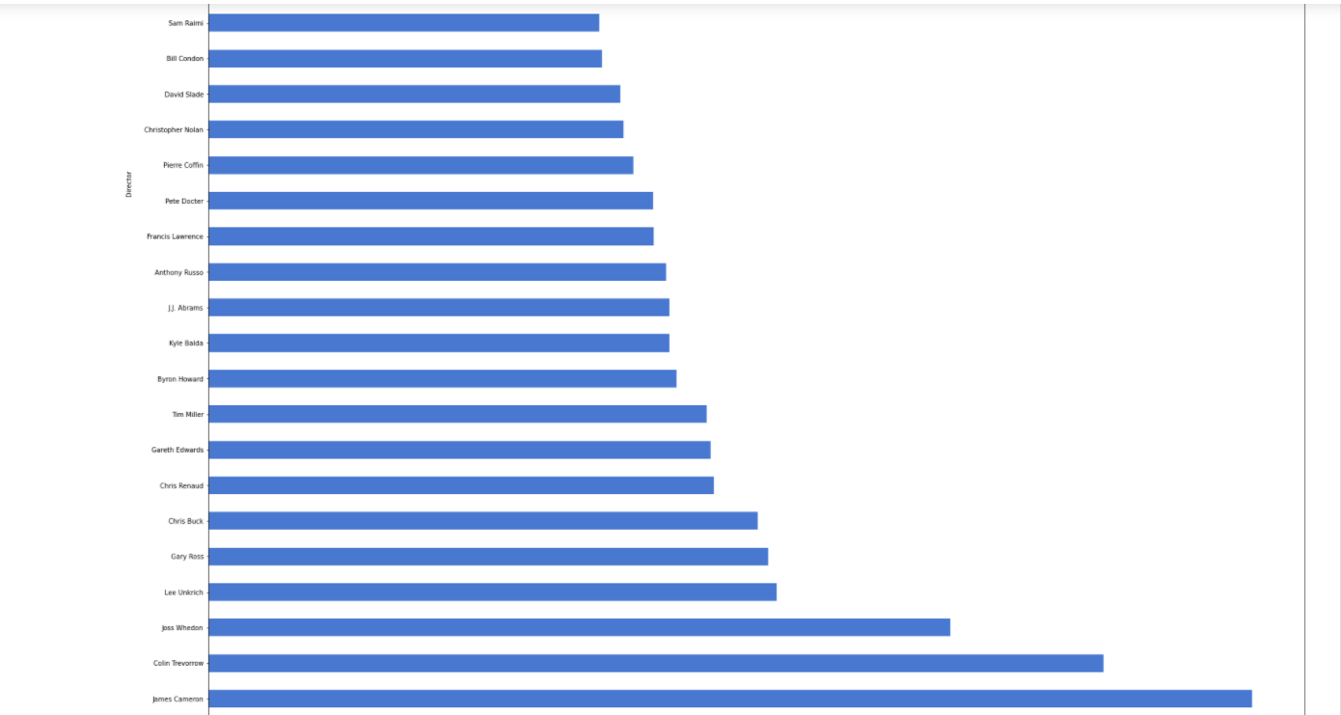
Directors with highest average revenue
This graph shows the directors who generate the most value.
James Cameron’s movies make $760 Million per movie. That’s not surprising considering Avatar alone made over $2 Billion

Slide 7
Conclusion
This a great time to make movies. The revenue has been consistently going up. However, do not expect to shatter sealings unless you are willing to make some investments on a good director
Choose experienced directors with name recognition.
Spend wisely and pick the correct genre

